Slide 1
ICT COMPETITION REGISTRATION GUIDE

Slide 2
HUAWEI ICT COMPETITION ALGERIA 2021-2022
① Visit the Platform: https://e.huawei.com/cn/talent/#/home ② Click “ICT Academy ICT Competition” to enter the ICT Competition HOME Page

Slide 3
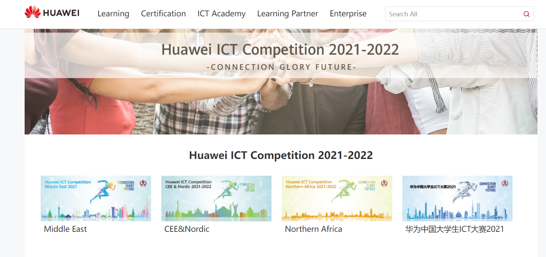
1. How to register for the Competition(unregistered accounts)
Choose Northern Africa competition.
Click “Competition Registration” to register.

Slide 4
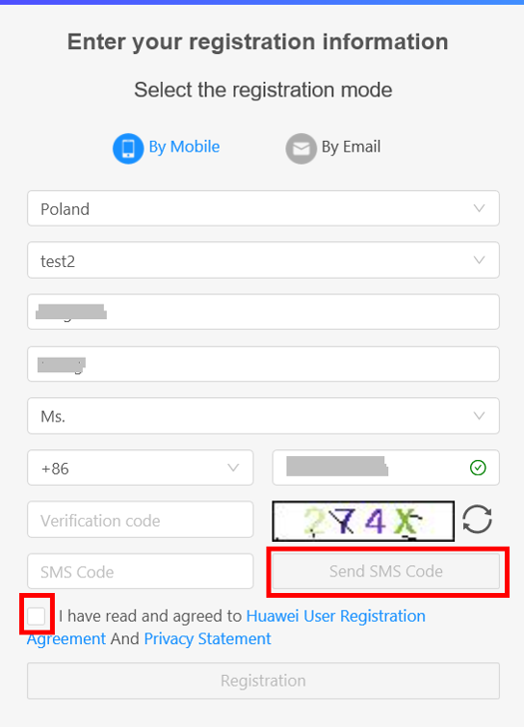
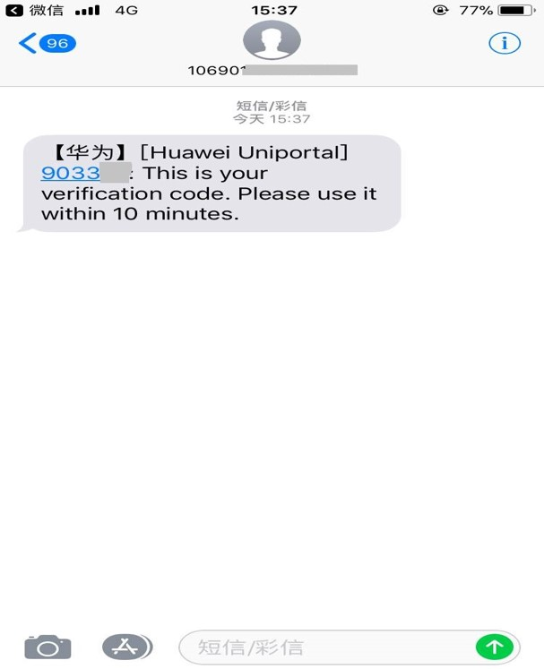
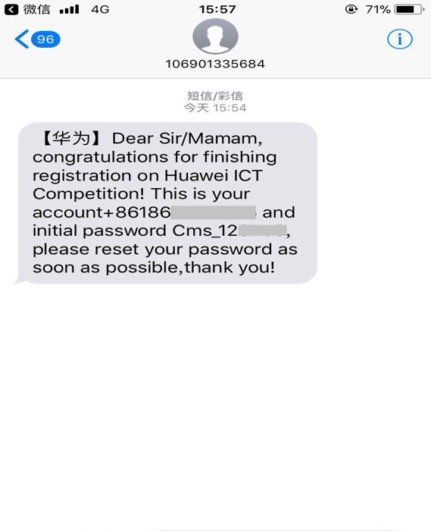
1.1 How to register for the Competition(unregistered accounts) “Register by Phone”
Fill in your personal information & receive the mobile phone verification code and enter
Registration is successful
Receive the text message including the account and initial password.
Make sure to Choose ALGERIA & Select your University

Slide 5
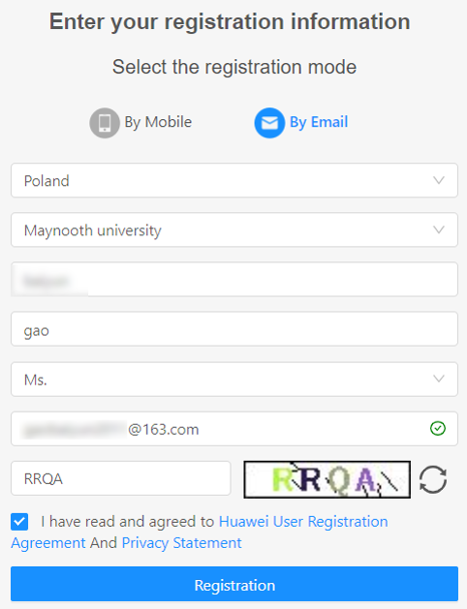
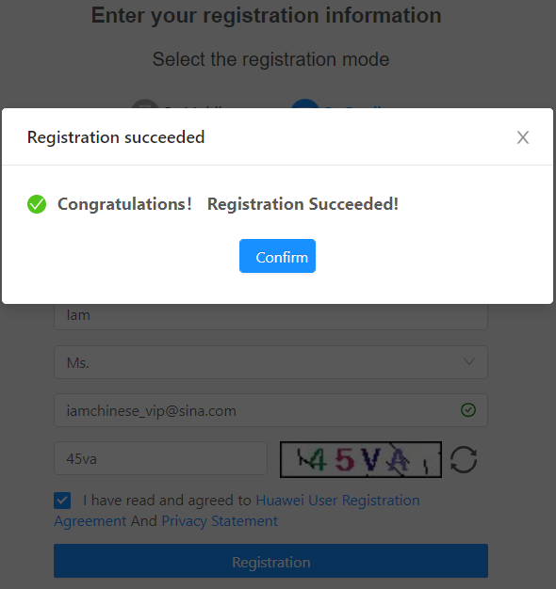
1.2 How to register for the Competition(unregistered accounts) “Register by Email”
Fill in your personal information.
.
① Activate Uniportal account (does not include accounts that have already been activated)
② Provide account password and suggest reset

Slide 6
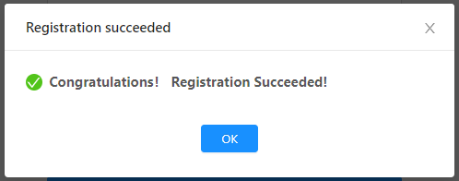
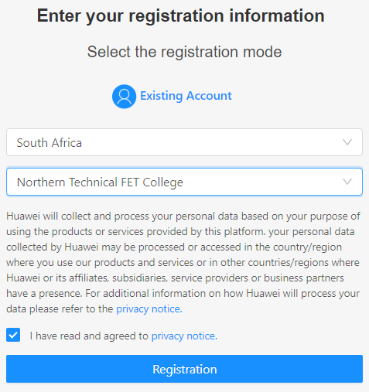
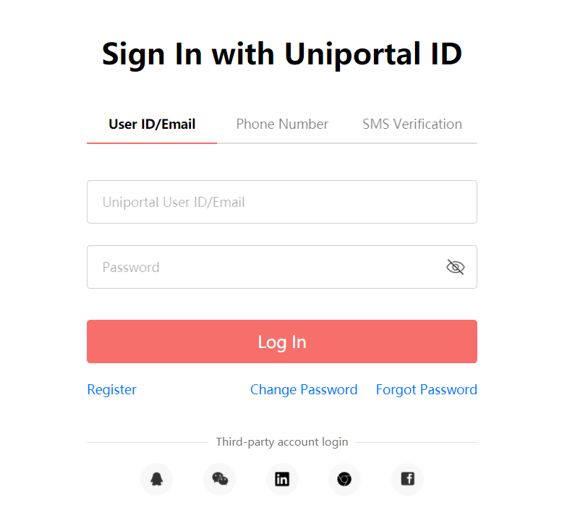
2. How to register for the Competition(Registered accounts)
1
5
4
2
3

Slide 7
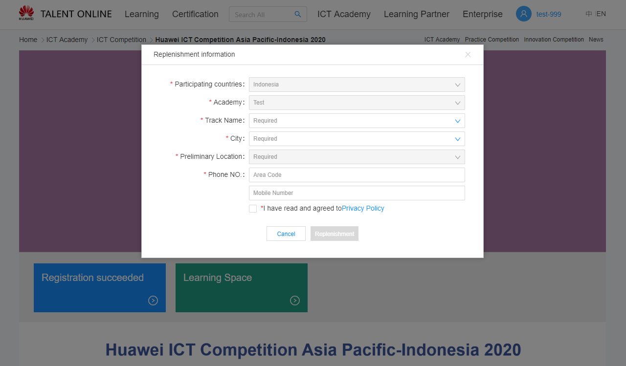
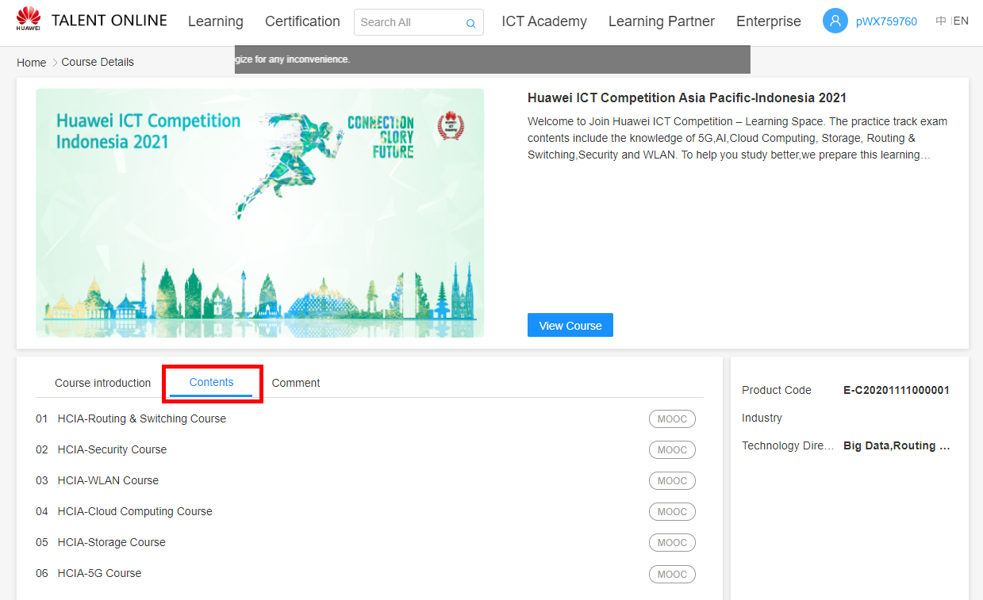
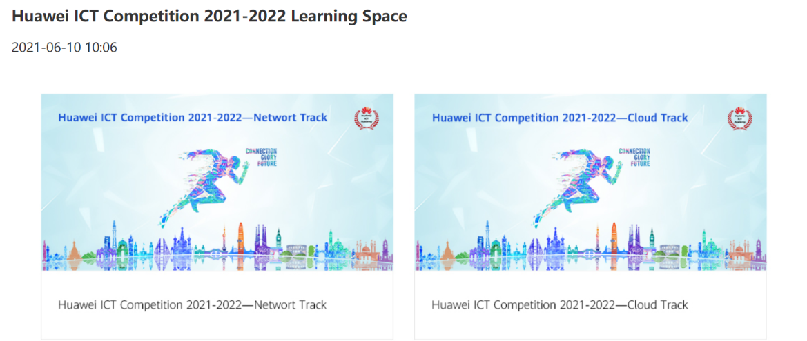
3. Replenishment Information & Start learning
Complete your basic info and enter Learning Space

Slide 8
THANK YOU

